Slide 1



HOME
ABOUT
CONTACT
APPLYING IMAGE PROCESSING TECHNIQUES
MP2
MAGPANTAY NINO JANDEL C.
BSCS 4B
MR BERNARDINO

Slide 2


HOME
ABOUT
CONTACT
INTRODUCTION TO IMAGE PROCESSING
Image processing involves techniques to manipulate and enhance digital images.
Goal: Improve image quality, highlight certain features, or prepare images for specific tasks, such as computer vision.

Slide 3


HOME
ABOUT
CONTACT
SCALING AND ROTATION
How it works: We use the cv2.resize function in OpenCV, which adjusts the image's dimensions based on a scale_factor. For example, scaling an image to 50% reduces its width and height by half.
Usage: Useful when you need images of different sizes for web applications, or to zoom in/out for feature analysis.
.
Scaling: Resizes an image by increasing or decreasing its width and height.

Slide 4
HOME
ABOUT
CONTACT
SCALING AND ROTATION
How it works: The cv2.getRotationMatrix2D function calculates a transformation matrix based on the image center and the desired rotation angle. Then, cv2.warpAffine applies this transformation.
Usage: Useful for aligning objects in images or adjusting orientation in analysis tasks.
Rotation: Turns the image by a specified angle

Slide 5

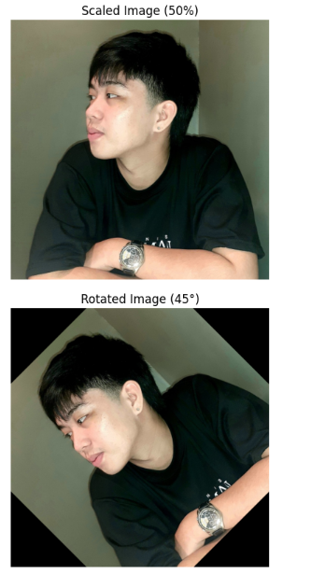
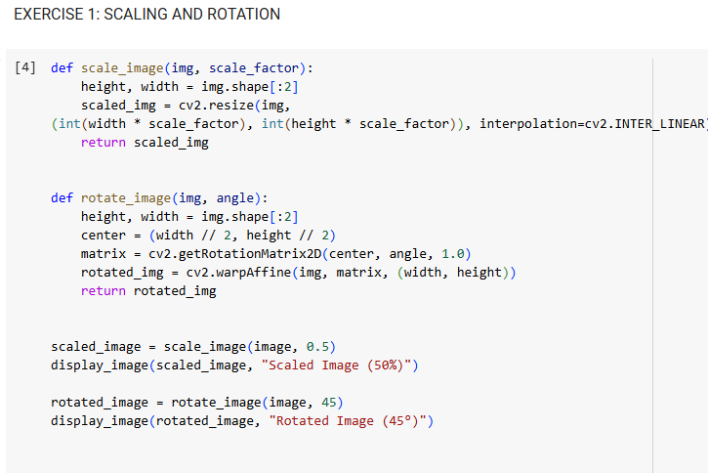
SALFORD & CO.
SCALING AND ROTATION
HOME
ABOUT
CONTACT

Slide 6
HOME
ABOUT
CONTACT
BLURRING TECHNIQUES
How it works: cv2.GaussianBlur applies a weighted average of neighboring pixels to smooth the image.
Usage: Reduces noise and detail, making it easier to detect objects in images.
Gaussian Blur: Uses a Gaussian function to create a smooth, blurred image

Slide 7
HOME
ABOUT
CONTACT
BLURRING TECHNIQUES
How it works: cv2.medianBlur sorts pixel values within a window and picks the median, making it effective for removing salt-and-pepper noise.
Median Blur: Replaces each pixel's value with the median of neighboring pixel values

Slide 8
HOME
ABOUT
CONTACT
BLURRING TECHNIQUES
How it works: cv2.bilateralFilter considers both spatial distance and intensity difference, keeping sharp edges intact.
Usage: Effective for tasks requiring noise reduction without losing important edges.
Bilateral Filter: Blurs while preserving edges

Slide 9
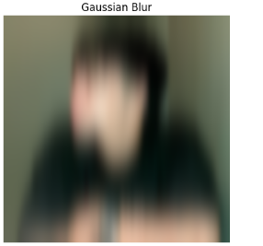
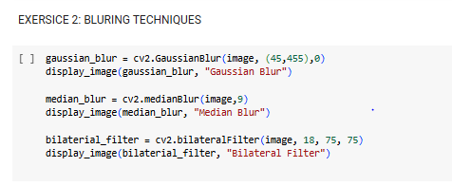
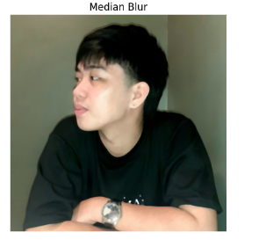
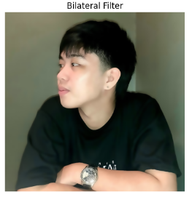
BLURRING TECHNIQUES
HOME
ABOUT
CONTACT

Slide 10
HOME
ABOUT
CONTACT
EDGE DETECTION USING CANNY
How it works: cv2.Canny uses gradient detection and thresholding to find edges. It’s a multi-step process that first applies a gradient filter, followed by non-maximum suppression and hysteresis to detect and link edges.
Usage: Common in object detection and feature extraction tasks.
Canny Edge Detection: Identifies the boundaries of objects in an image.

Slide 11
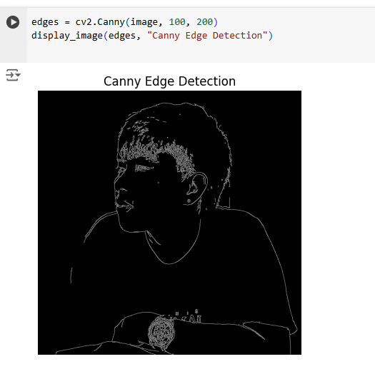
EDGE DETECTION USING CANNY
HOME
ABOUT
CONTACT

Slide 12
HOME
ABOUT
CONTACT
PROBLEM-SOLVING WITH IMAGE PROCESSING TECHNIQUES
Scenario 3: Smooth an image while preserving important edges for further analysis. → Solution: Use bilateral filtering.
Scenario 4: Identify object boundaries in an image to help with segmentation. → Solution: Use Canny edge detection.
Scenario 1: You need to reduce the file size of an image without losing too much detail. → Solution: Apply scaling.
Scenario 2: Align an image for better analysis by rotating it. → Solution: Apply rotation.

Slide 13
HOME
ABOUT
CONTACT
CONCLUSION
Image processing techniques such as scaling, rotation, blurring, and edge detection are key tools in enhancing images and preparing them for tasks like computer vision or further analysis.
Each method serves different use cases depending on the task, noise levels, and required features.

Slide 14

SALFORD & CO.
HOME
ABOUT
CONTACT
THANK YOU

